Slide 1
SAPM
ASSIGNMENT-2
Technical Analysis

Slide 2
Nishant Sahoo-2020AAPS2097H
Archis Sahu- 2020A7PS1692H
Prakhar Bhargava-2020A4PS2276H
Sayyam Tiwari -2020A2PS2476H
Group - 7

Slide 3
Stock Selection
HDFC
TCS
Sun Pharma
Nestle
Asian Paints

Slide 4
Company overview
ASIAN PAINTS
Asian Paints' portfolio includes a wide range of paint products, including decorative paints, industrial coatings, and automotive coatings. The company has a strong focus on innovation and offers a variety of specialized paint products for different applications and surfaces.
TCS
TCS provides a wide range of services including software development, infrastructure management, business process outsourcing, and engineering services.
NESTLE
Company was founded in 1866 and has since grown to become one of the world's largest food and beverage companies, with operations in more than 190 countries and a workforce of over 300,000 employees.
SUNPHARMA
Sun Pharma's portfolio includes a wide range of pharmaceutical products such as branded and generic drugs, over-the-counter medications, and active pharmaceutical ingredients (APIs).
HDFC
HDFC's portfolio includes services such as retail banking, wholesale banking, and treasury operations. It is primarily known for its housing finance business, which provides a variety of home loan products to individuals and families in India.

Slide 5
Technical Indicators
Bollinger Bands: If the price is near the upper band, it is considered over
bought, and if it is near the lower band, it is considered oversold. Traders
enter trades when the price action confirms the analysis. For example, if the
price is near the lower band and other indicators show oversold conditions, traders may enter a long position.
RSI: RSI values range from 0 to 100, with values above 70 indicating overbought conditions and values below 30 indicating oversold conditions.If the price is making higher highs but the RSI is making lower highs, it may indicate a potential trend reversal. If the RSI is in oversold conditions and the price action is showing signs of a reversal, traders may enter a long position.

Slide 6
Technical Indicators (Cont.)
Candlestick Chart: Identify key support and resistance levels on the chart
that may indicate potential price levels where the security may reverse or
continue the trend. If there is a bullish engulfing pattern near a key support
level and other indicators show oversold conditions, traders may enter a long position.
Stochastic Oscillator: This indicator consists of two lines, the %K line and the %D line. The %K line is the faster line and the %D line is the slower line. When the lines are above 80, it is considered overbought, and when the lines are below 20, it is considered oversold. If the price is making higher highs but the stochastic oscillator is making lower highs, it may indicate a potential trend reversal. If the stochastic oscillator is in oversold conditions and the price action is showing signs of a reversal, traders may enter a long position.

Slide 7
HDFC Bank

Slide 8
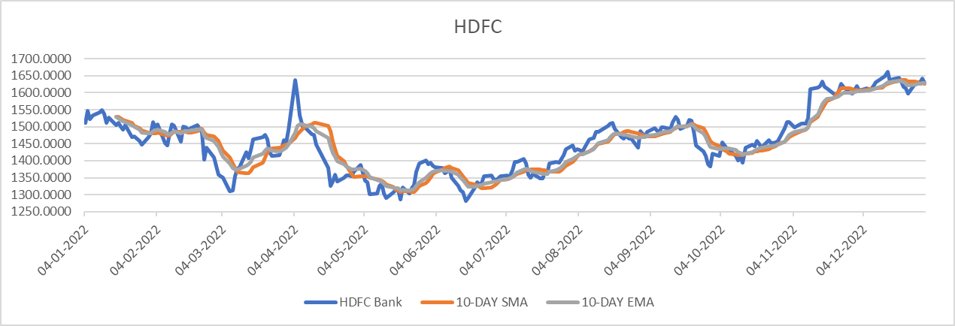
HDFC line chart and 10 day SMA and EMA

Slide 9
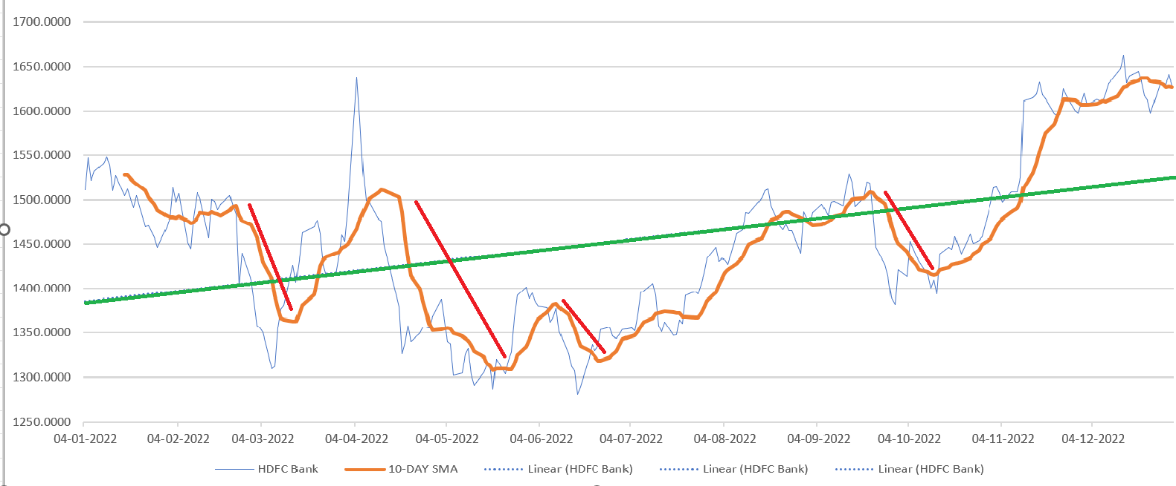
HDFC primary and secondary trends

Slide 10
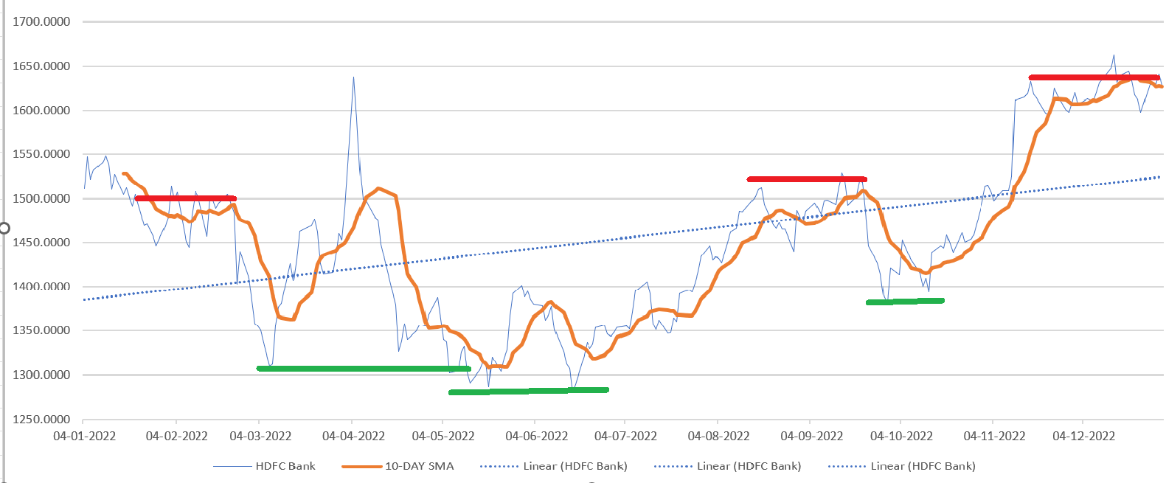
HDFC support and resistance

Slide 11
Asian Paints

Slide 12
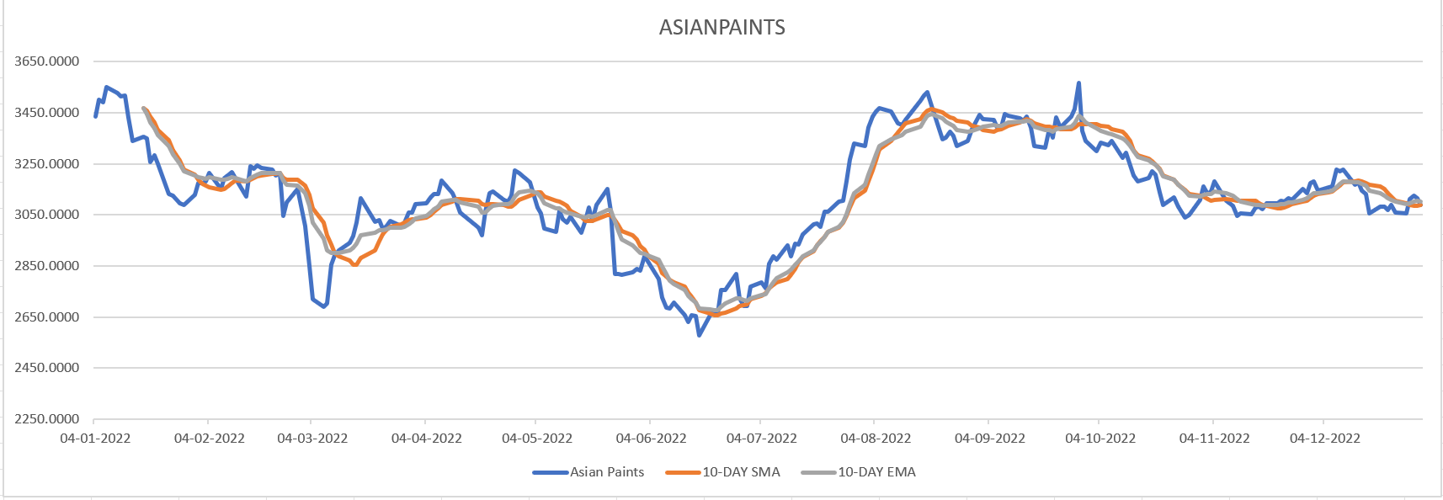
Asian paints line chart and 10 day sma and ema

Slide 13
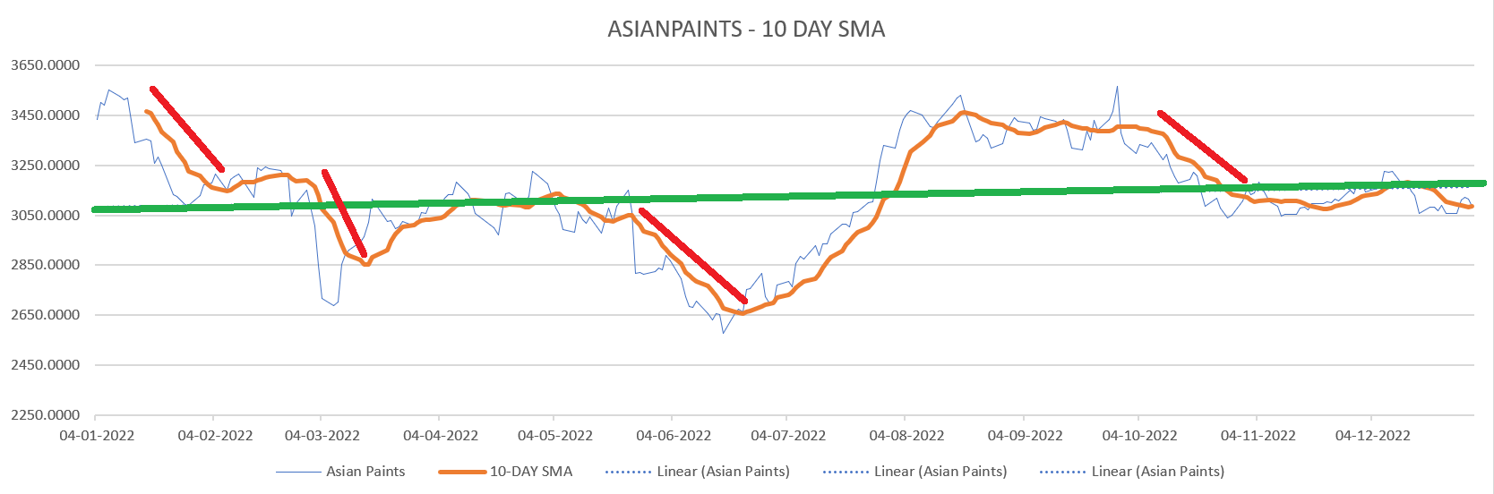
Asian paints primary and secondary trends

Slide 14
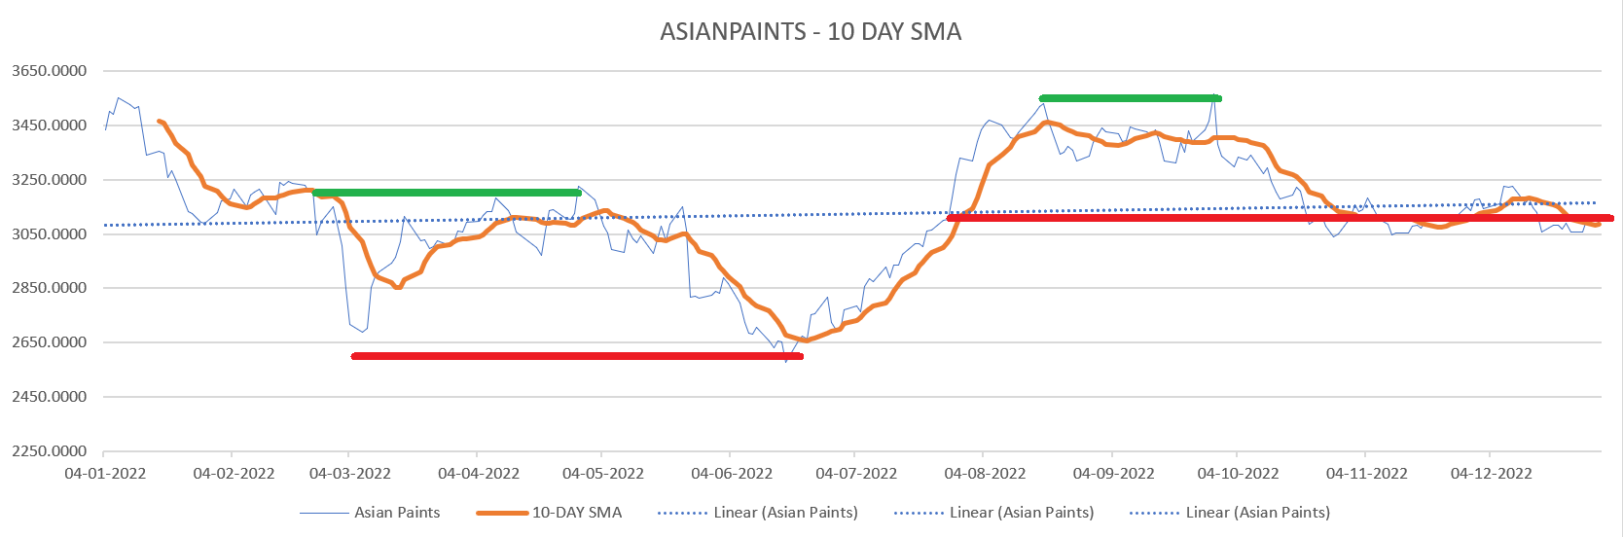
Asian paints support and resistance

Slide 15
Nestle

Slide 16
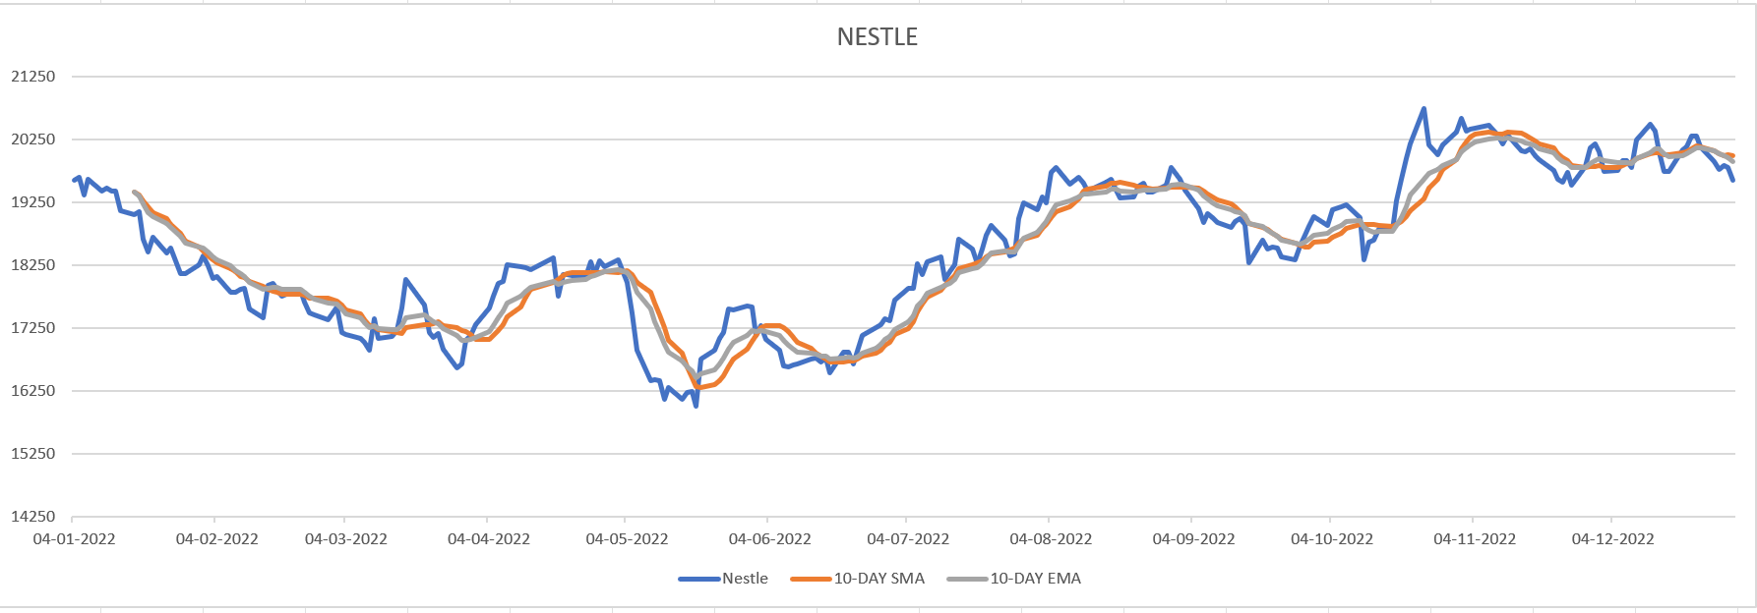
Nestle line chart and 10 day sma and ema

Slide 17
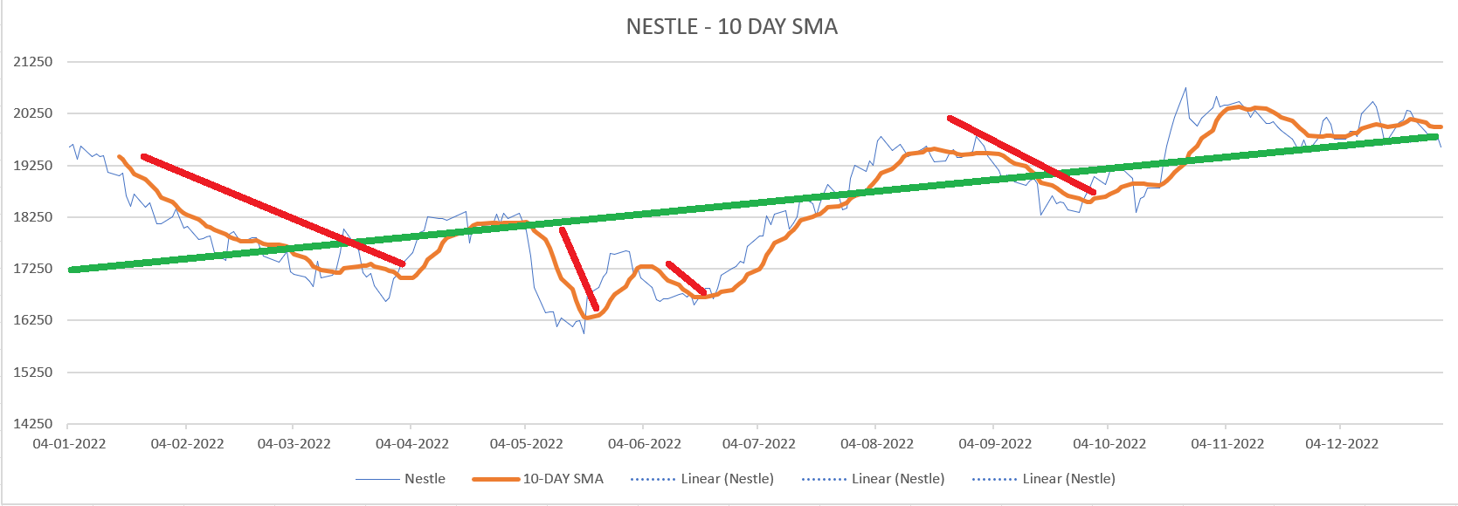
Nestle primary and secondary trends

Slide 18
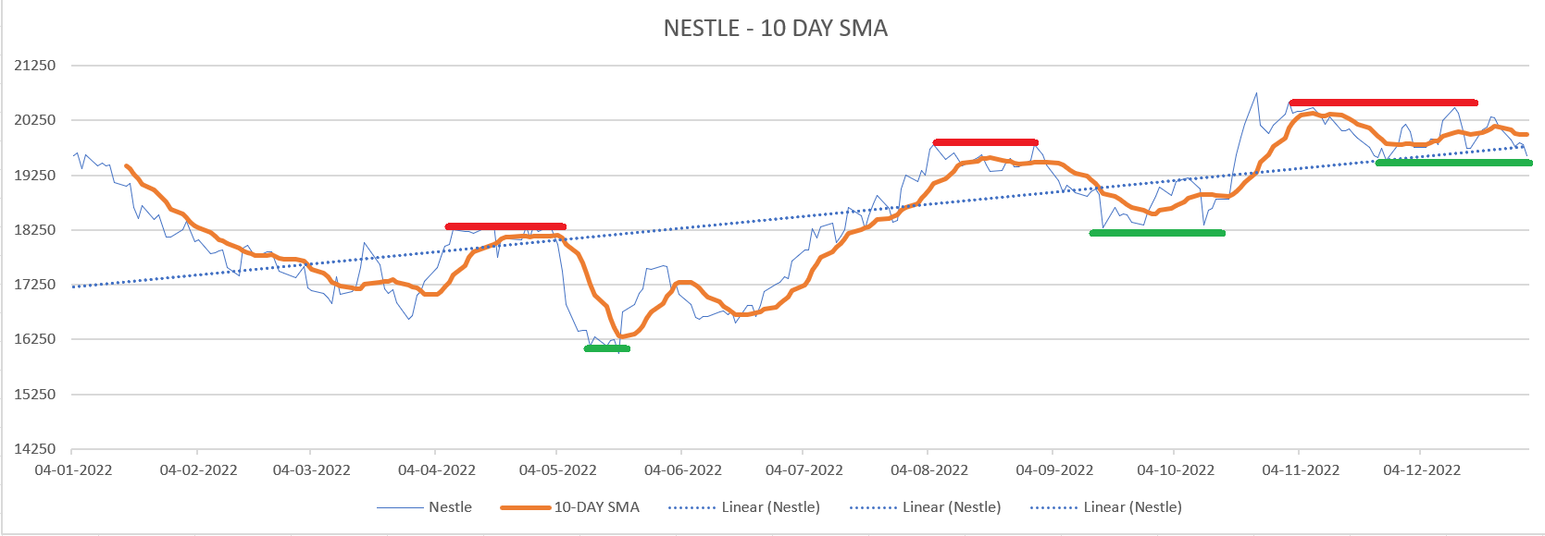
Nestle support and resistance

Slide 19
TCS

Slide 20
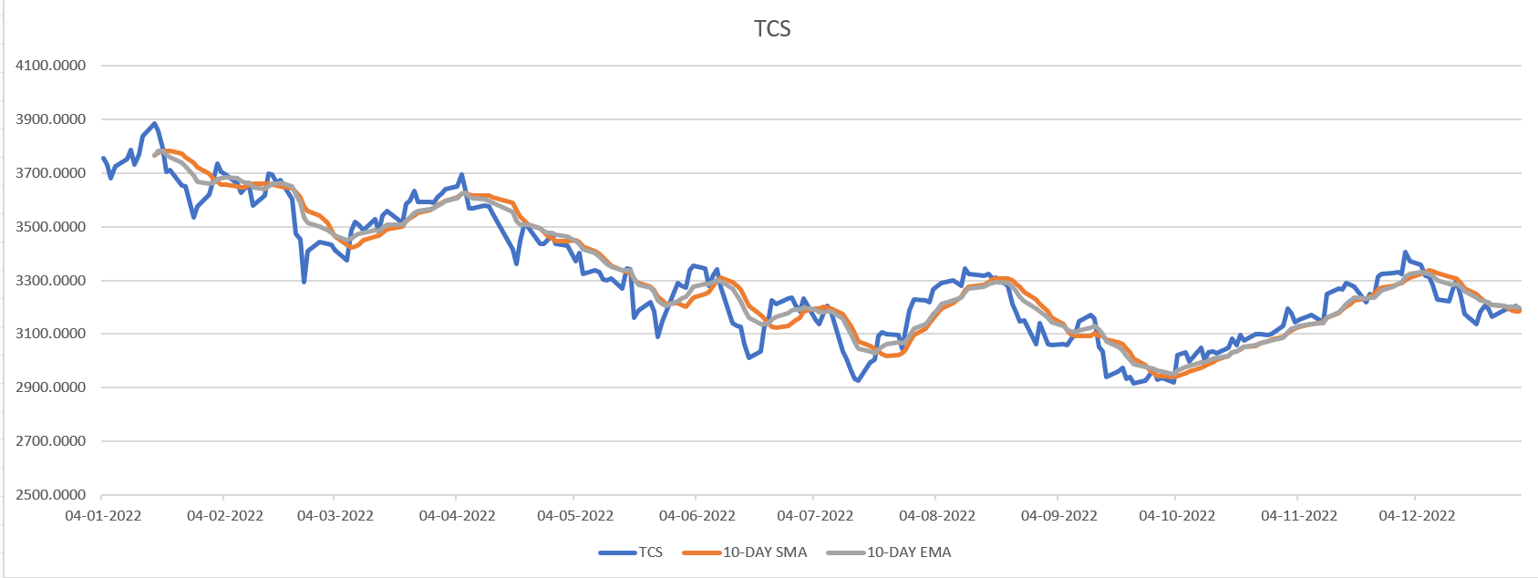
TCS line chart and 10 day sma and ema

Slide 21
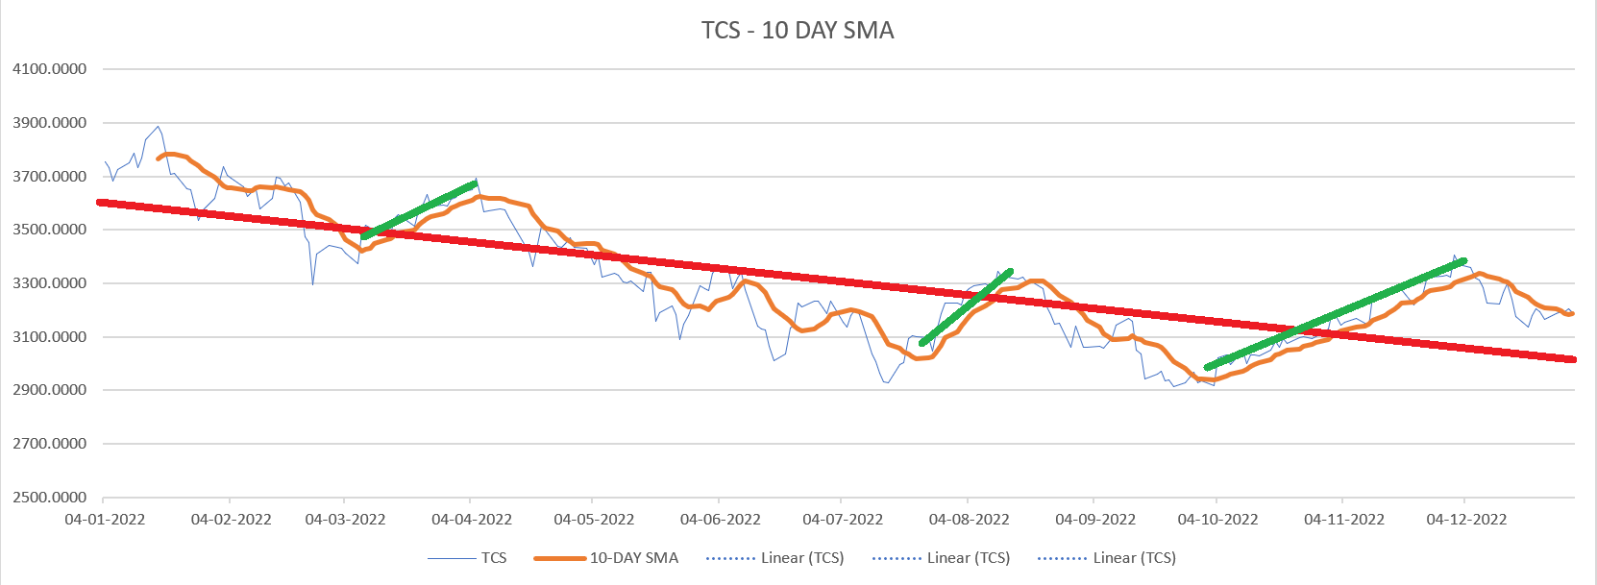
Nestle primary and secondary trend

Slide 22
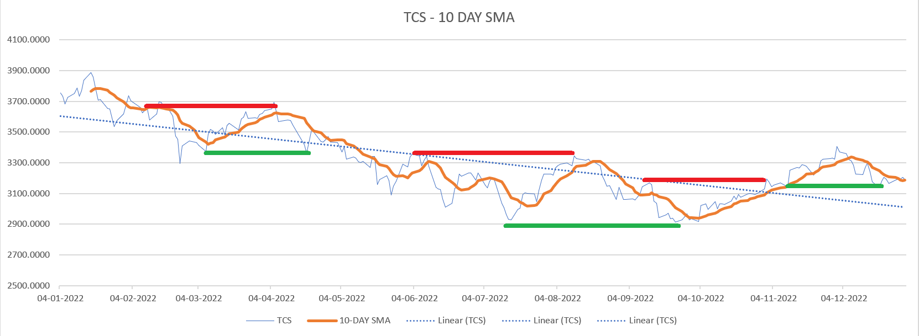
Nestle support and resistance

Slide 23
Sun Pharma

Slide 24
Sun Pharma line chart and 10 day sma and ema

Slide 25
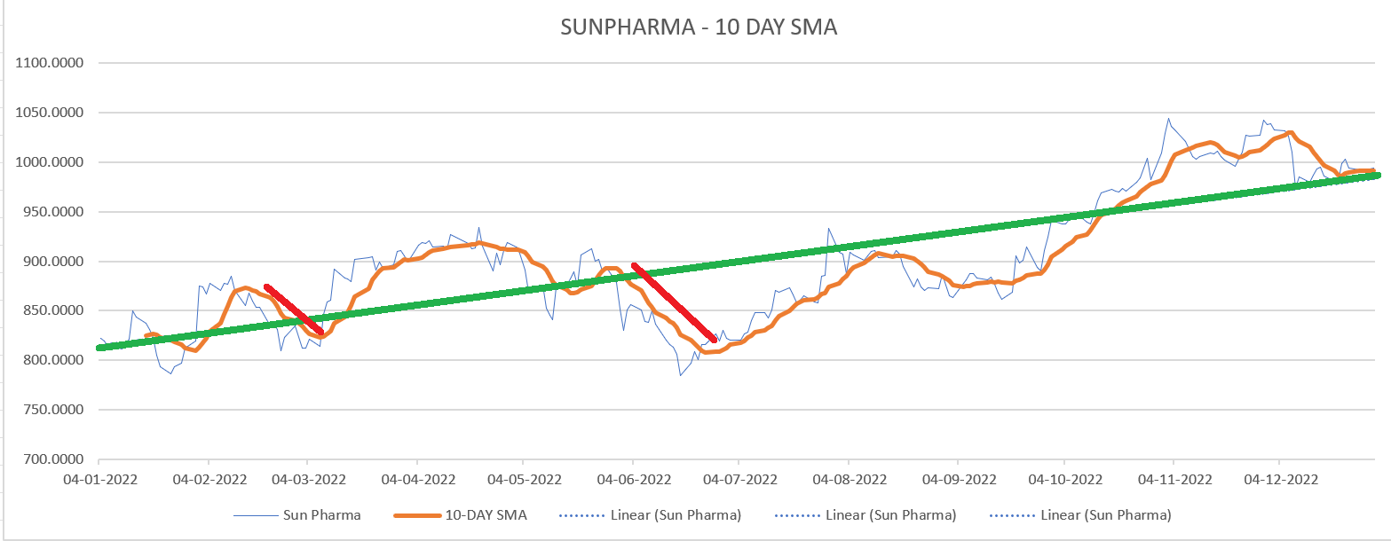
Sun Pharma Primary and secondary resistance

Slide 26
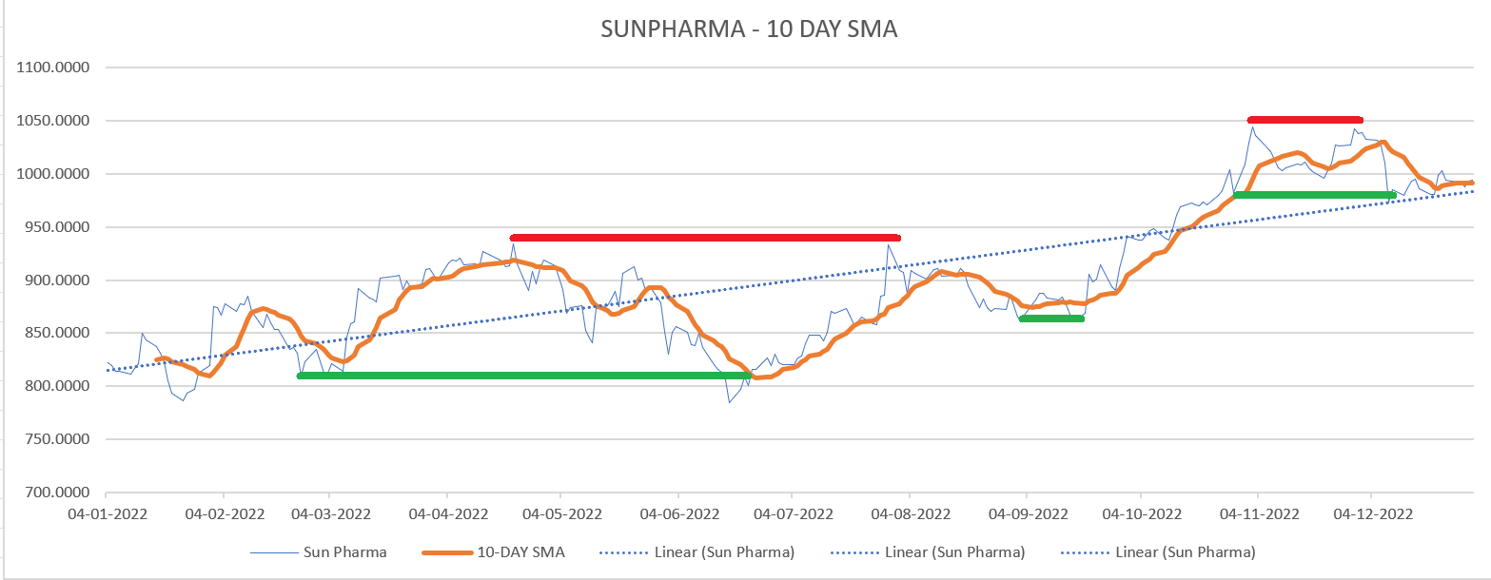
Sun Pharma support and resistance

Slide 27
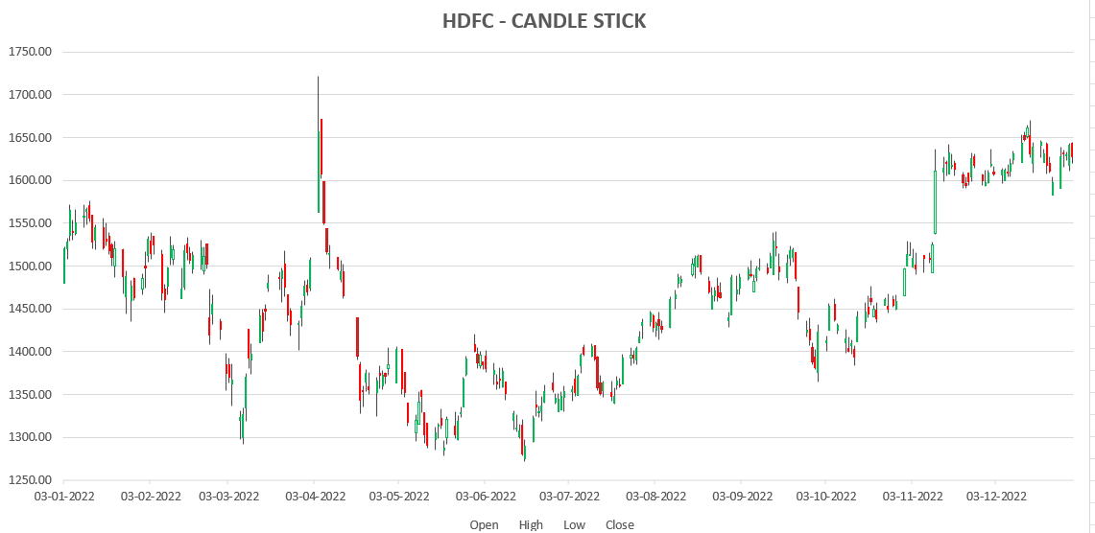
HDFC candlestick

Slide 28
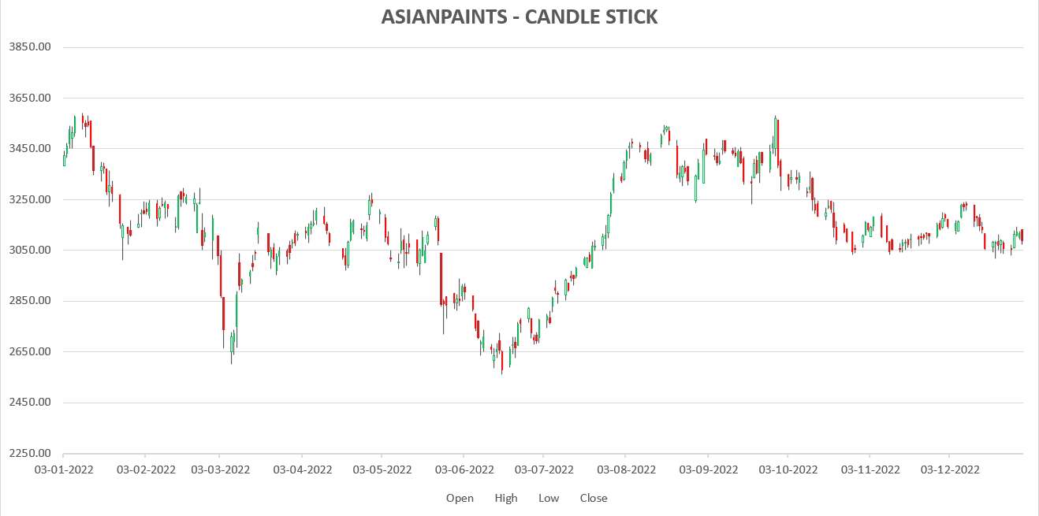
Asian Paints candlestick

Slide 29
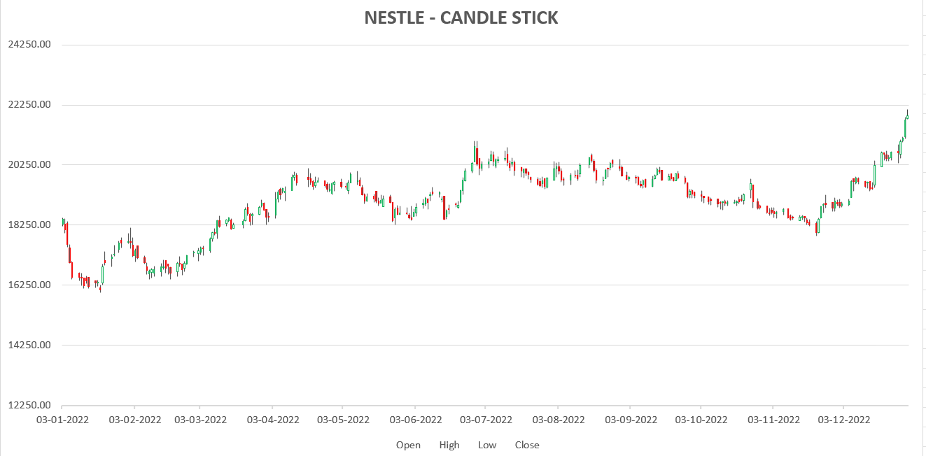
Nestle candlestick

Slide 30
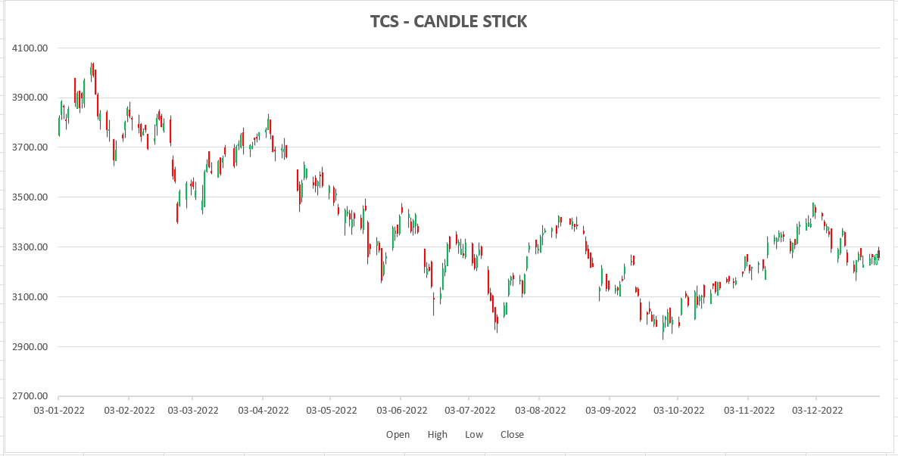
TCS candlestick

Slide 31
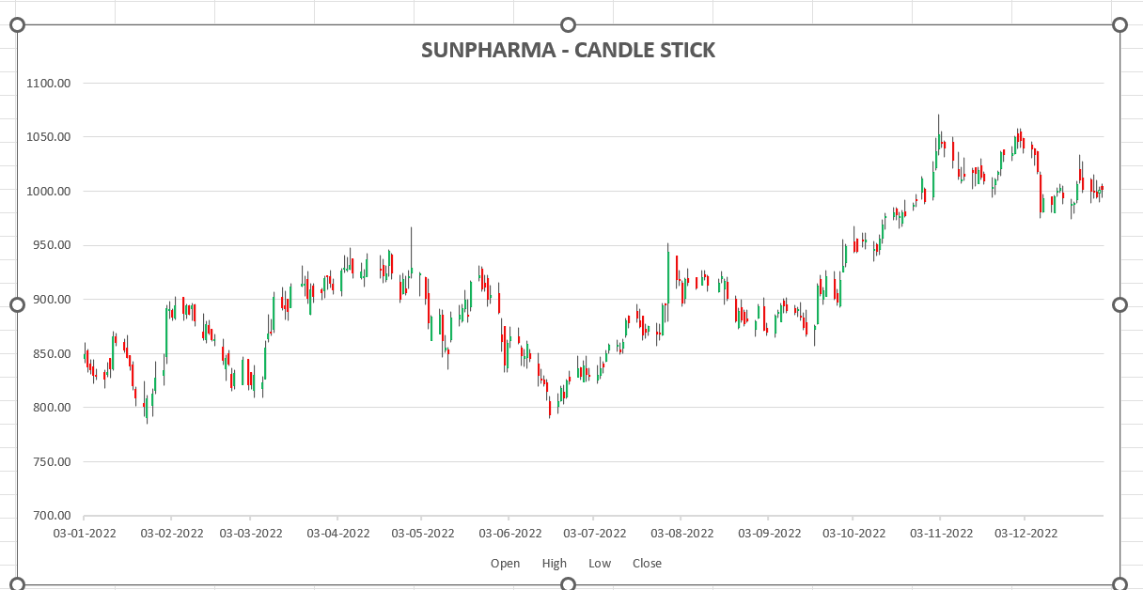
Sunpharma candlestick

Slide 32
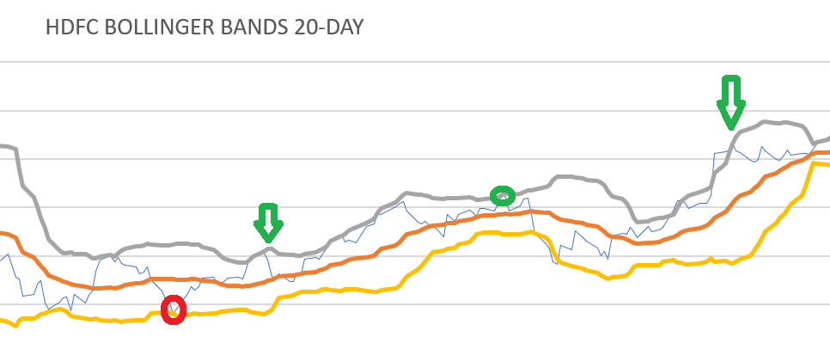
Bollinger bands for HDFC
In the above case we can see that the red circle denotes the point where the lower band is met and thus it shows buying signal and as expected the price rose up from there
In the green circle the upperbound is crossed thus indicating the stock needs to be sold and as seen in the trend the price has reduced from that point
Fake signals : the arrow mark represent the fake signals as we can see even after the crossover the trend remained the same instead of expected from the signal

Slide 33
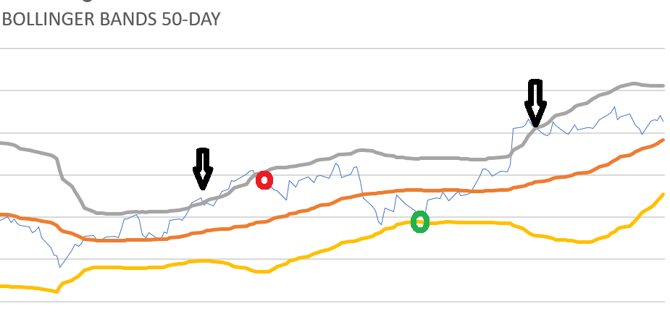
Bollinger bands for HDFC
In the above case we can see that the green circle denotes the point where the lower band is met and thus it shows buying signal and as expected the price rose up from there
In the red circle the upperbound is crossed thus indicating the stock needs to be sold and as seen in the trend the price has reduced from that point
Fake signals : the arrow mark represent the fake signals as we can see even after the crossover the trend remained the same instead of expected from the signal

Slide 34
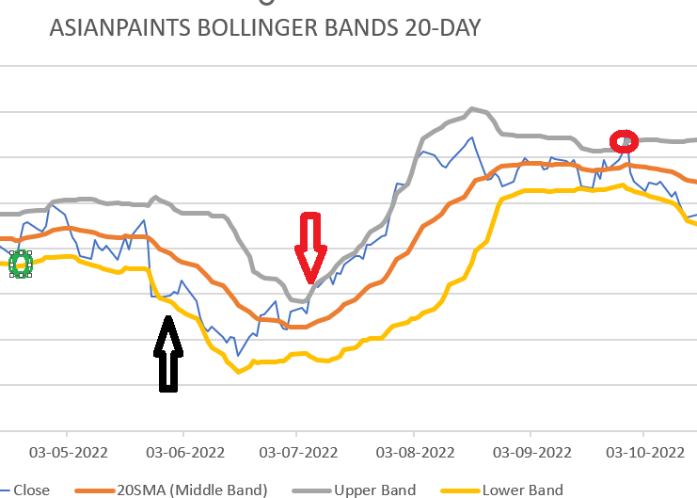
Bollinger bands for Asian paints
In the above case we can see that the green circle around beginning of may denotes the point where the lower band is met and thus it shows buying signal and as expected the price rose up from there
In the red around beginning of october circle the upperbound is crossed thus indicating the stock needs to be sold and as seen in the trend the price has reduced from that point
Fake signals : the arrow mark in june and july represent the fake signals as we can see even after the crossover the trend remained the same instead of expected from the signal

Slide 35
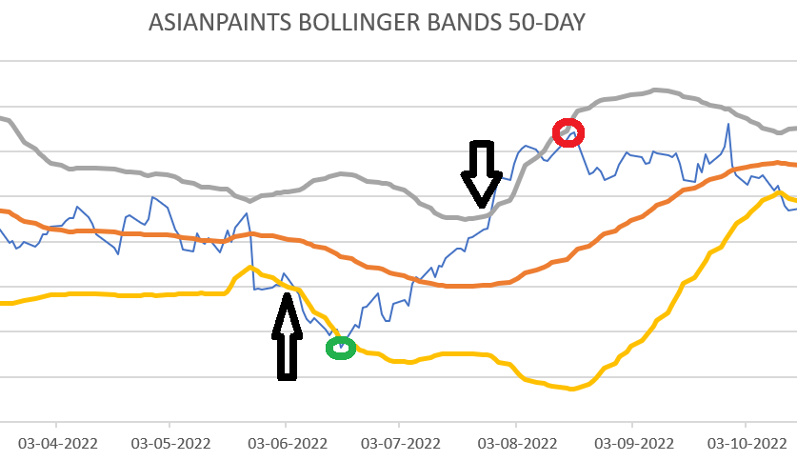
Bollinger bands for Asian paints
In the above case we can see that the green circle around june denotes the point where the lower band is met and thus it shows buying signal and as expected the price rose up from there
In the red circle around august the upperbound is crossed thus indicating the stock needs to be sold and as seen in the trend the price has reduced from that point
Fake signals : the arrow mark around and towards beginning of june represent the fake signals as we can see even after the crossover mid julyhe trend remained the same instead of expected from the signal

Slide 36
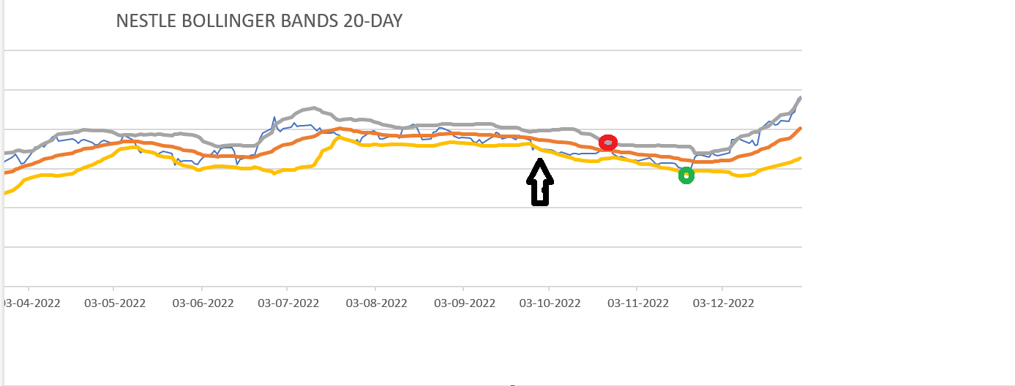
Bollinger bands for Nestle
In the above case we can see that the green circle around decemeber denotes the point where the lower band is met and thus it shows buying signal and as expected the price rose up from there
In the red circle around august the upperbound is crossed thus indicating the stock needs to be sold and as seen in the trend the price has reduced from that point
Fake signals : the arrow mark around and towards mid ocotber represent the fake signals as we can see even after the crossover the trend remained the same instead of expected from the signal

Slide 37
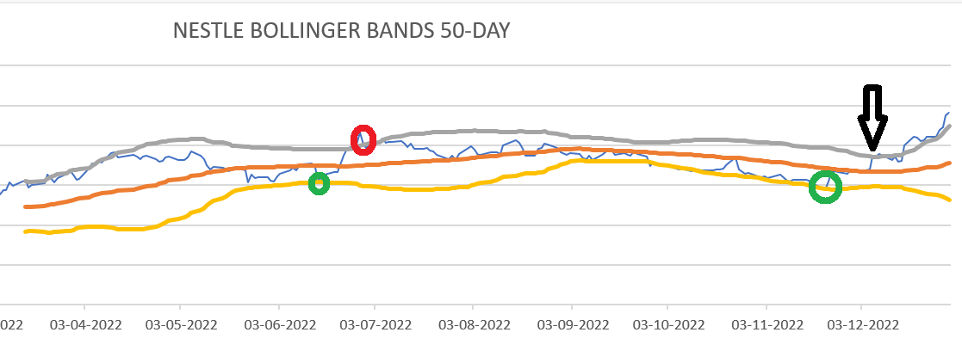
Bollinger bands for Nestle
In the above case we can see that the green circle around decemeber and mid june denotes the point where the lower band is met and thus it shows buying signal and as expected the price rose up from there
In the red circle around july the upperbound is crossed thus indicating the stock needs to be sold and as seen in the trend the price has reduced from that point
Fake signals : the arrow mark around and towards december represent the fake signals as we can see even after the crossover the trend remained the same instead of expected from the signal

Slide 38
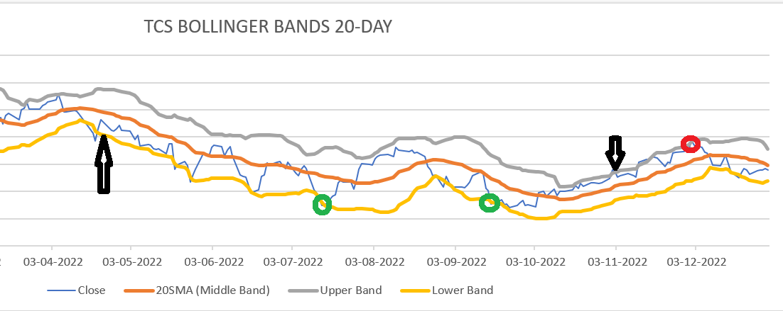
Bollinger bands for TCS
In the above case we can see that the green circle around mid july and mid september denotes the point where the lower band is met and thus it shows buying signal and as expected the price rose up from there
In the red circle around december the upperbound is crossed thus indicating the stock needs to be sold and as seen in the trend the price has reduced from that point
Fake signals : the arrow mark around and towards november and mid june represent the fake signals as we can see even after the crossover the trend remained the same instead of expected from the signal

Slide 39
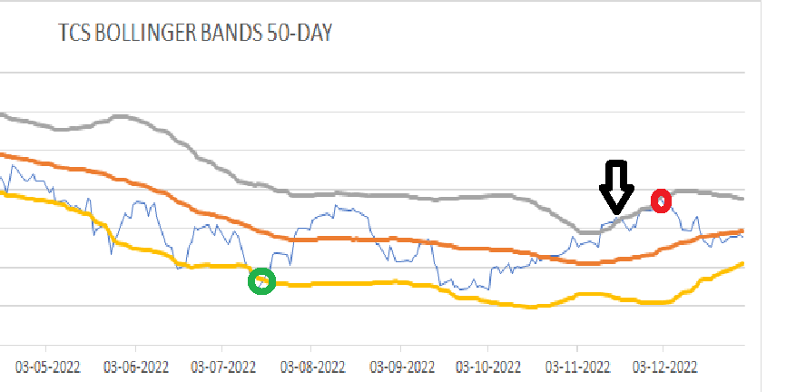
Bollinger bands for TCS
In the above case we can see that the green circle around mid july denotes the point where the lower band is met and thus it shows buying signal and as expected the price rose up from there
In the red circle around december the upperbound is crossed thus indicating the stock needs to be sold and as seen in the trend the price has reduced from that point
Fake signals : the arrow mark around and towards november represent the fake signals as we can see even after the crossover the trend remained the same instead of expected from the signal

Slide 40
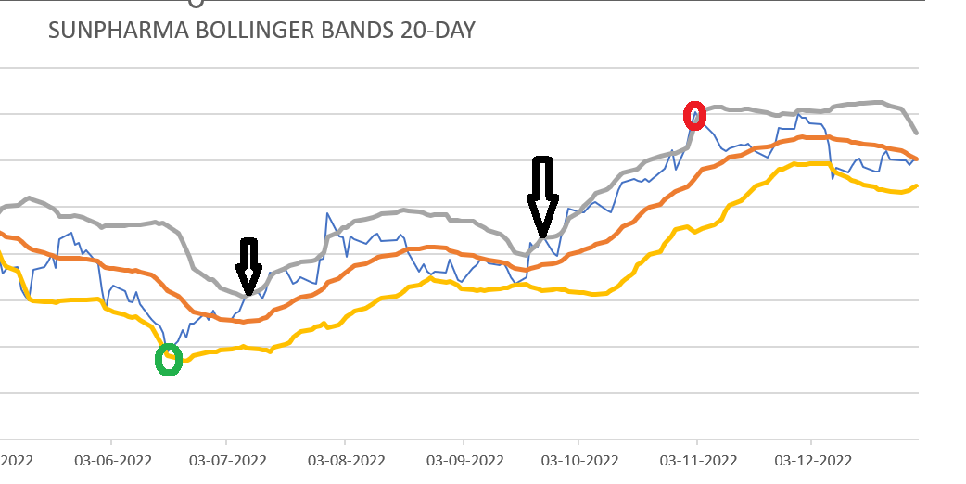
Bollinger bands for Sunpharma
In the above case we can see that the green circle around mid june denotes the point where the lower band is met and thus it shows buying signal and as expected the price rose up from there
In the red circle around november the upperbound is crossed thus indicating the stock needs to be sold and as seen in the trend the price has reduced from that point
Fake signals : the arrow mark around and towards july and october represent the fake signals as we can see even after the crossover the trend remained the same instead of expected from the signal

Slide 41
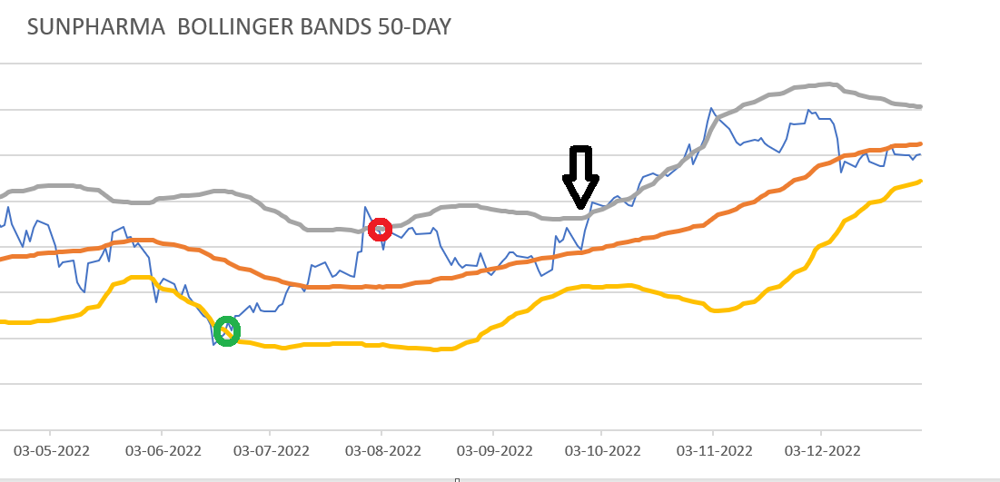
Bollinger bands for Sunpharma
In the above case we can see that the green circle around mid june denotes the point where the lower band is met and thus it shows buying signal and as expected the price rose up from there
In the red circle around august the upperbound is crossed thus indicating the stock needs to be sold and as seen in the trend the price has reduced from that point
Fake signals : the arrow mark around and towards october represent the fake signals as we can see even after the crossover the trend remained the same instead of expected from the signal

Slide 42
Using Rsi for investment strategy
1. Calculate the RSI: Calculate the RSI using the following formula:
RSI = 100 - (100 / (1 + RS))
Where RS = Average gain over the specified time period / Average loss over the specified time period.
2. Determine the overbought and oversold levels: Set the overbought and oversold levels based on the stock's historical price data. A common setting is to use 70 for overbought and 30 for oversold.
3. Identify the trading signals: Look for the RSI to cross above the oversold level (30) which can indicate a buy signal, and look for the RSI to cross below the overbought level (70) which can indicate a sell signal.
4. Set stop-loss orders: To manage risk, set stop-loss orders below the support level if buying or above the resistance level if selling.
5. Take profits: Take profits at predetermined levels, such as the next Fibonacci level, a previous high or low, or a key psychological level.
6. Adjust the time frame for the short run or medium run: Use a shorter time frame (such as a 14-day period) for the short run and a longer time frame (such as a 28-day period) for the medium run.

Slide 43
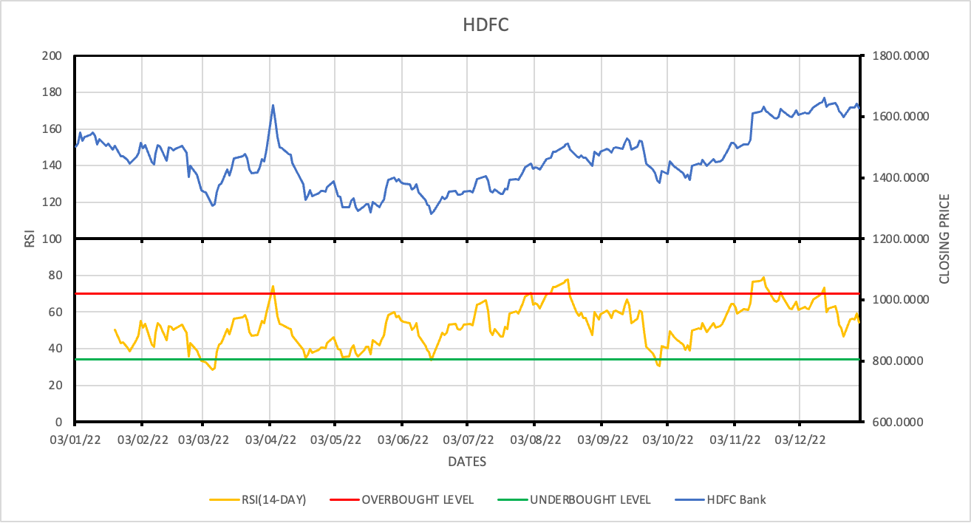
RSI for HDFC
We have considered a 14-day window for short-term.
Our strategy suggests to SELL when RSI > 70 and BUY when RSI < 34
We can see the successful trades in the image above.

Slide 44
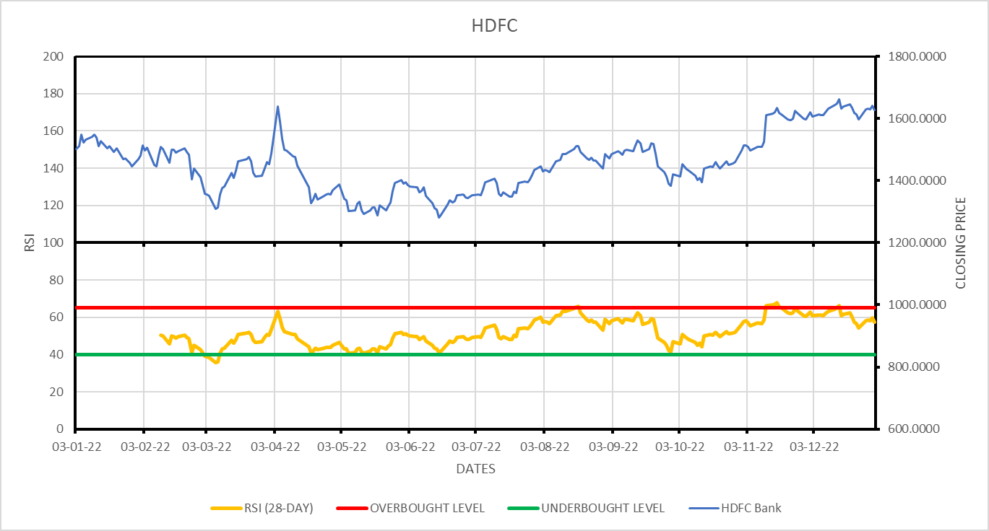
RSI for HDFC
We have considered a 28-day window for medium-term.
Our strategy suggests to SELL when RSI > 65 and BUY when RSI < 40
We can see the successful trades in the image above.

Slide 45
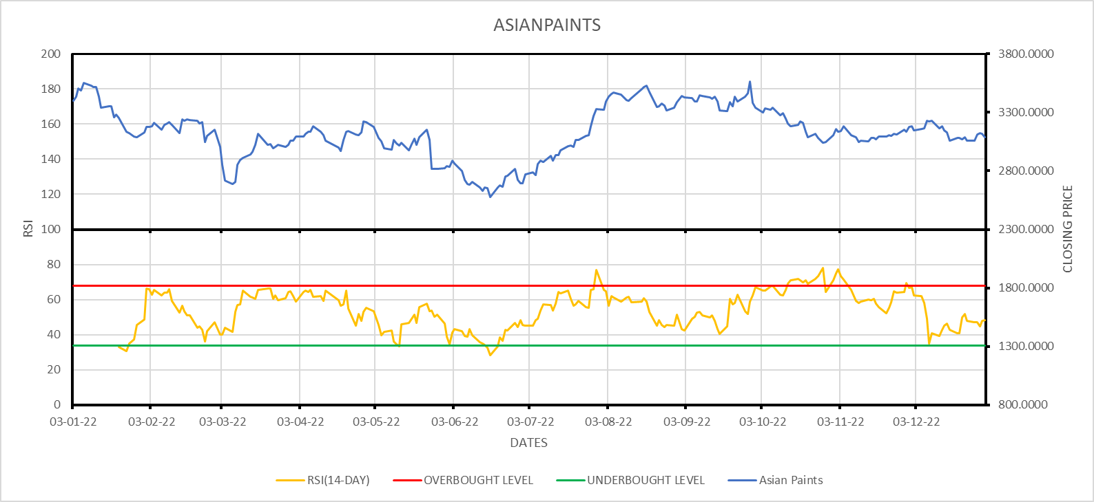
RSI for Asian Paints
We have considered a 14-day window for short-term.
Our strategy suggests to SELL when RSI > 68 and BUY when RSI < 34
We can see the successful trades in the image above.

Slide 46
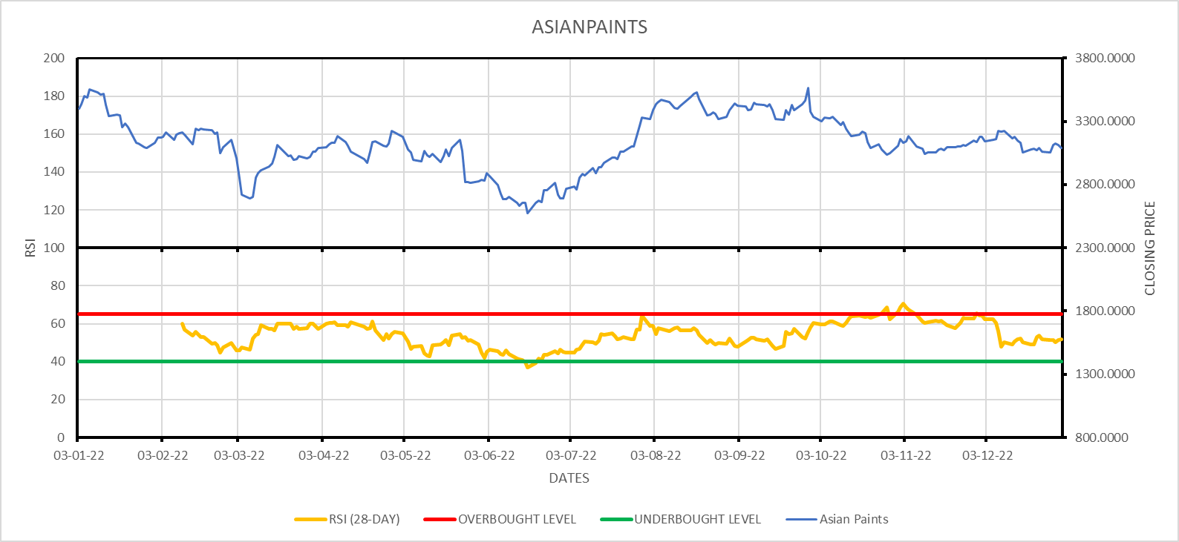
RSI for Asian Paints
We have considered a 28-day window for medium-term.
Our strategy suggests to SELL when RSI > 65 and BUY when RSI < 40
We can see the successful trades in the image above.

Slide 47
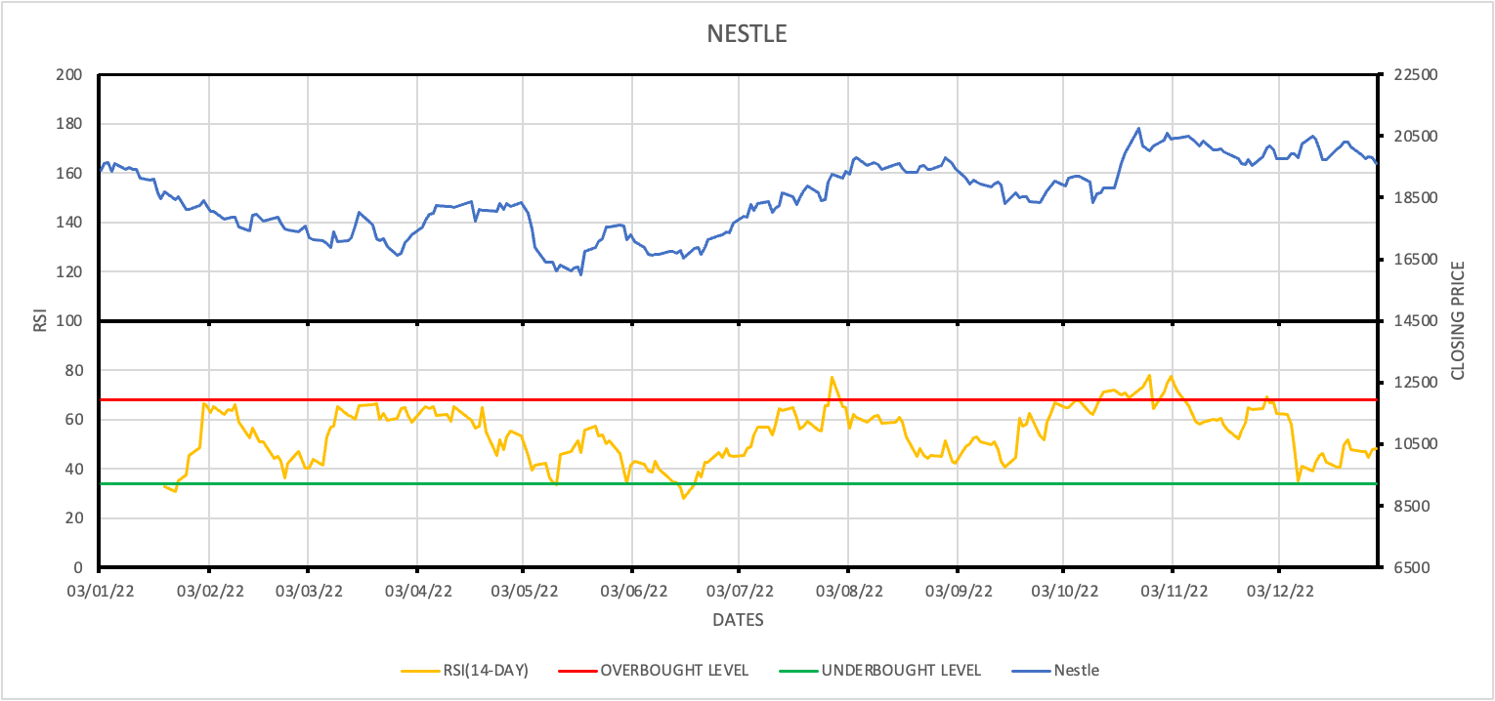
RSI for NESTLE
For the short term we have considered a window of 14 days
Our strategy suggests that whenever RSI is above 68 we must SELL and below 34 we must BUY
We can see the successful trades in the image above.
FAKE SIGNALS: the SELL signal at 29/7/22 is a false one on short term as the prices don’t fall low enough within the following month.

Slide 48
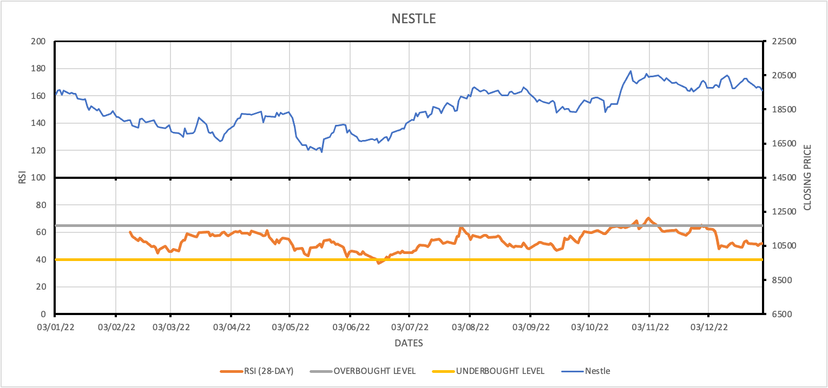
RSI for NESTLE
For the medium term we have considered a window of 28 days.
Our strategy suggests that whenever RSI is above 65 we must SELL and below 40 we must BUY
We can see the successful trades in the image above.

Slide 49
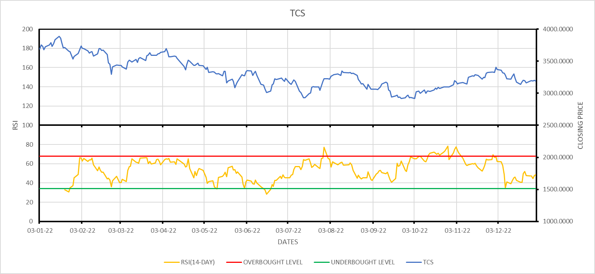
RSI for TCS
We have considered a 14-day window for short-term.
Our strategy suggests to SELL when RSI > 68 and BUY when RSI < 34
We can see the successful trades in the image above.

Slide 50
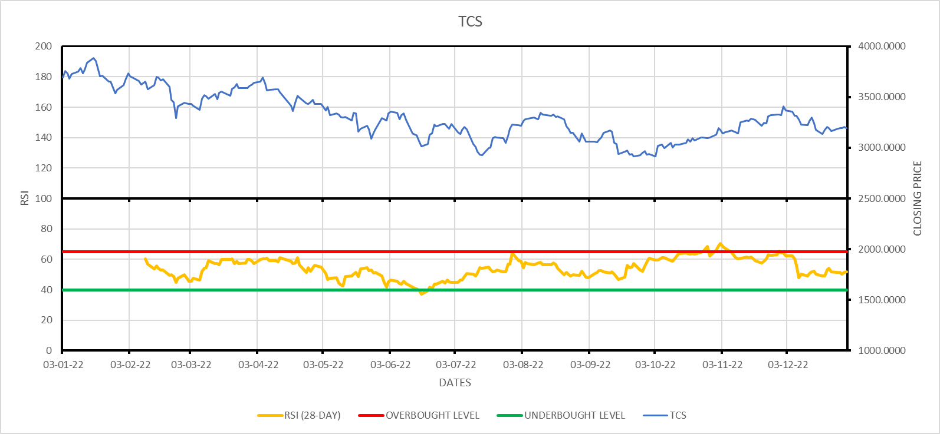
RSI for TCS
We have considered a 28-day window for medium-term.
Our strategy suggests to SELL when RSI > 65 and BUY when RSI < 40
We can see the successful trades in the image above.

Slide 51
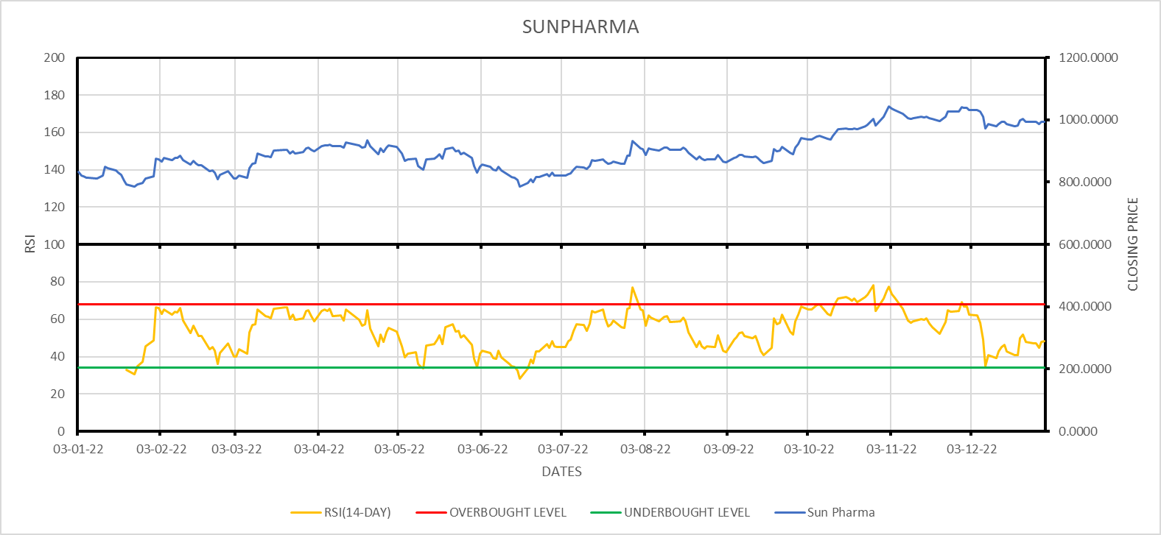
RSI for Sun Pharma
We have considered a 14-day window for short-term.
Our strategy suggests to SELL when RSI > 68 and BUY when RSI < 34
We can see the successful trades in the image above.

Slide 52
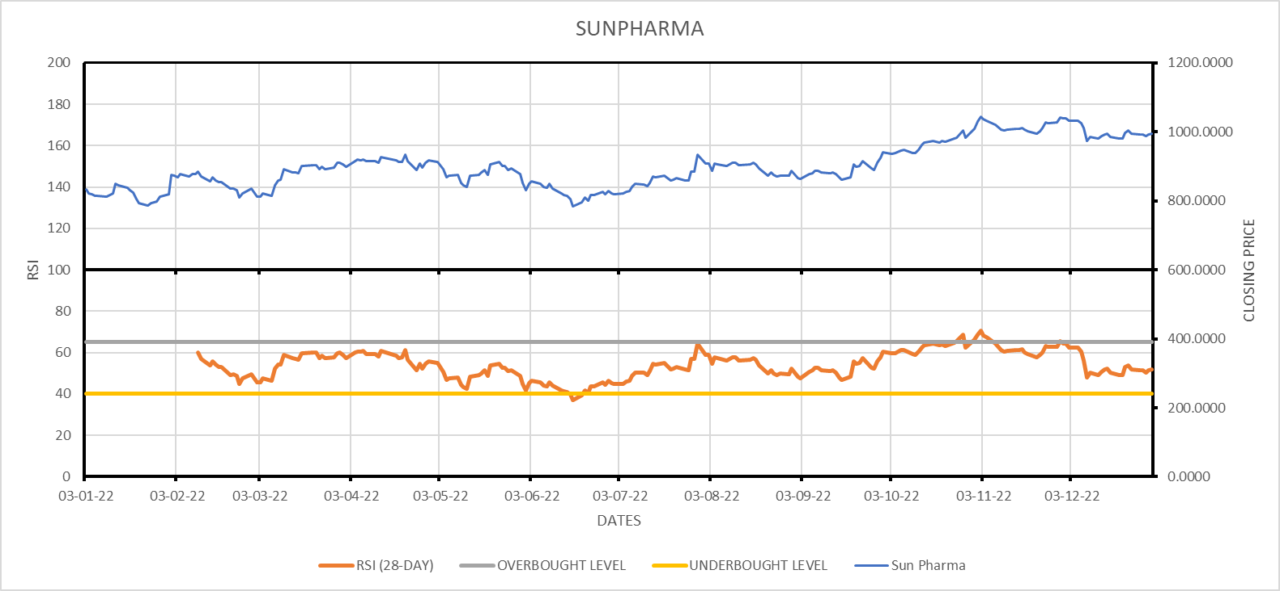
RSI for Sun Pharma
We have considered a 28-day window for medium-term.
Our strategy suggests to SELL when RSI > 65 and BUY when RSI < 40
We can see the successful trades in the image above.

Slide 53
Using the stochastic oscillator to formulate a trading strategy
Calculate %K and %D for the stochastic oscillator using the following formulae-
%K = (Current Close - Lowest Low)/(Highest High - Lowest Low) * 100
%D = 3-day simple moving average of %K
Determine the overbought and oversold levels: Set the overbought and oversold levels based on the stock's historical price data. A common setting is to use 80 for overbought and 20 for oversold.
Identify the trading signals: Look for the %K line to cross above the %D line when the stock is oversold (below 20), which can indicate a buy signal. Conversely, look for the %K line to cross below the %D line when the stock is overbought (above 80), which can indicate a sell signal.
We have used the stochastic oscillator as an extension of the RSI to confirm the signals.

Slide 54
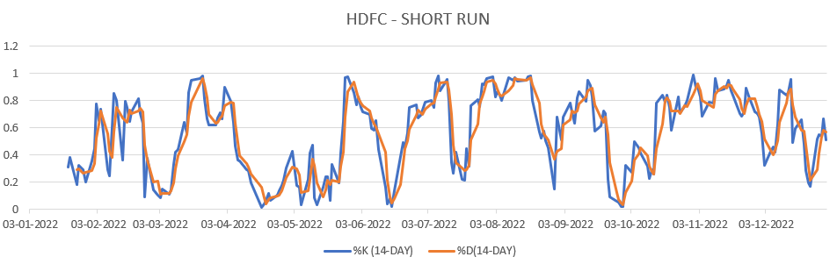
SO for HDFC
We have considered a 14 day period for the short run
When the %K line crosses the %D line when the stock is oversold, it is a buy signal
When the %K line falls below the %D line when the stock is overbought, it is a sell signal
In the beginning of Feb, May and September, %K line crossed the %D line indicating a signal to buy more of the stock

Slide 55
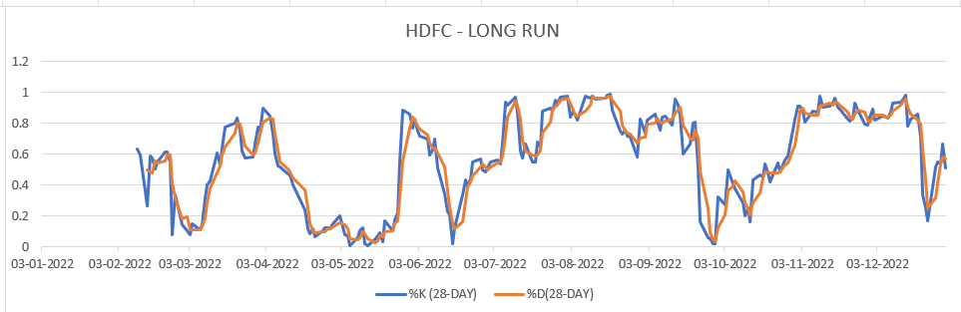
SO for HDFC(long run)
1) We have considered a 28 day period for the long run
2) The %K line falls below the %D line multiple times in the August to October period, which indicates that the stock is overbought and must be sold

Slide 56
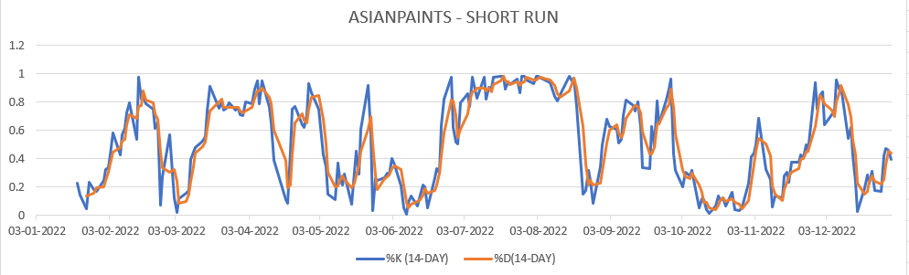
SO for Asianpaints(short run)
1) We have considered a 14 day period for the short run
2) When the %K line crosses the %D line when the stock is oversold, it is a buy signal
3) When the %K line falls below the %D line when the stock is overbought, it is a sell signal
4) This happens from March through April which indicates that the Asianpaints stock is oversold

Slide 57
SO for Asian Paints(long run)
1) We have considered a 28 day period for the long run
2) The %D line crosses the %K line multiple times in the April-May period and the November-December period.
3) These instances indicate that the stock is overbought and must be sold

Slide 58
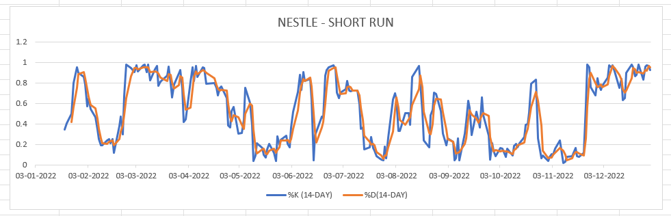
SO for Nestle(short run)
1) We have considered a 14 day period for the short run
2) When the %K line crosses the %D line when the stock is oversold, it is a buy signal
3) When the %K line falls below the %D line when the stock is overbought, it is a sell signal
4) We can see that the %K line crosses the %D line at the start of March which means the stock is oversold and is a buying signal

Slide 59
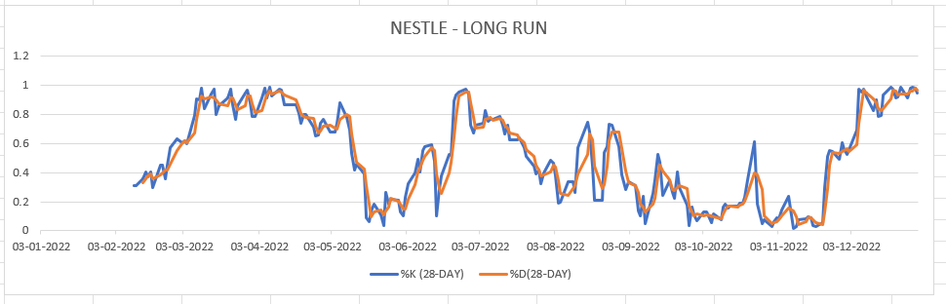
SO for Nestle(long run)
1) We have considered a 28 day period for the long run
2) The %K line crosses the %D line multiple times in March-April, which indicates a buy signal
3) The %D line crosses the %K line at the start of September, which is a selling signal

Slide 60
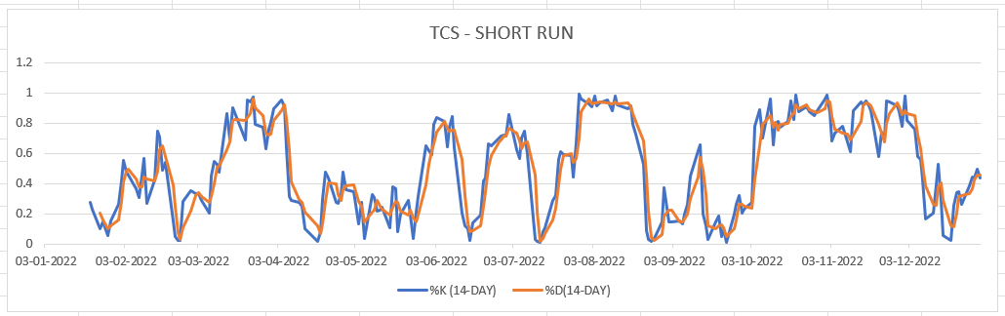
SO for TCS(short run)
1) We have considered a 14 day period for the short run
2) When the %K line crosses the %D line when the stock is oversold, it is a buy signal
3) When the %K line falls below the %D line when the stock is overbought, it is a sell signal
4) We can see the buy signal occurring at the beginning of March and the sell signal through the august -september period

Slide 61
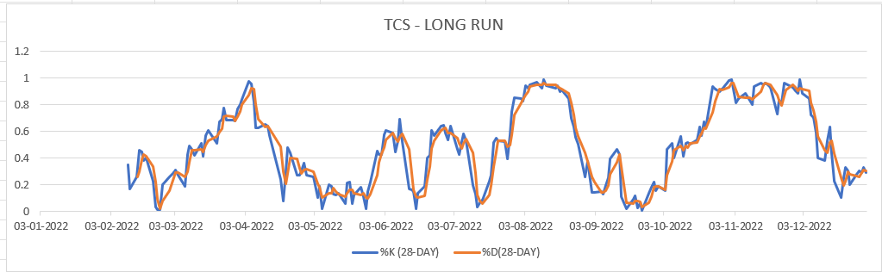
SO for TCS(long run)
1) We have considered a 28 day period for the long run
1) The buy signal is seen consistently in the May-June period and the sell signal occurs multiple times in the june-july period.

Slide 62
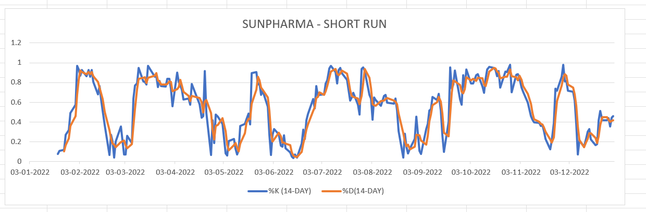
SO for Sunpharma(short run)
1) We have considered a 14 day period for the short run
2) When the %K line crosses the %D line when the stock is oversold, it is a buy signal
3) When the %K line falls below the %D line when the stock is overbought, it is a sell signal
4) We can see that in June the stock is clearly oversold and hence should be bought

Slide 63
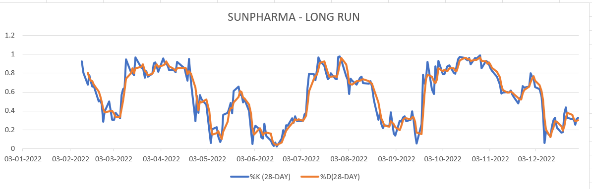
SO for Sunpharma(long run)
1) We have considered a 28 day period for the long run
2) In the june to August period, the %K line is consistently alive the %D lie and hence indicates that the stock is oversold and must be bought
3) The opposite happens in the April-May period where we can see multiple drops in the %K line, indicating that the stock is overbought and hence must be sold.

Slide 64
Portfolio
Equal-weighted portfolio of the five selected securities
3-month Return | -3.98%
3-month Standard Deviation | 1.20%
Annualised Return | -14.99%
Annualised Risk | 4.89%

Slide 65
Thank you

